Slide 1

Descriptive Statistics: A Recap

Slide 2
Mean, median and mode
1

Slide 3
Mean
The mean is simply the average value. We obtain it by summing all values and dividing it by the total number of values.
Example: 10 + 45 + 28 + 108 + 24 + 92 + 54 = 361/7 = 51.57

Slide 4
Median
The median is a value which separates the data into two equal parts: a high-valued range of data points and a low-valued range of data points. 50% of our data will be on the left side of the median value, whereas 50% of our data will be on the right side of it.
First Example (Uneven): 1 - 4 - 7 - 12 - 65 - 88, 99
Second Example (Even): 6, 8, 9, 11, 12, 19, 9 + 11 / 2 = 10

Slide 5
Mode
The mode is the value the occurs most frequently:
Example: 0,2,4,1,5,5,4,1,5
Example: 3, 3, 6, 9, 16, 16, 16, 27, 27, 37, 48

Slide 6
Distributions
2

Slide 7
Distributions
A distribution is a list, table or plot in which the frequency of each of the values are shown or listed.
Name | Age
Carl | 44
Rita | 41
John | 42
Jennifer | 43
Aron | 43
Frequency/ Count/ Percentage
Age

Slide 8
Skewness
Skewness measures to what extent the distribution is symmetric.
If the mean value is equal to the median value, then the distribution is not skewed.
If the mean value is not equal to the median value, then the distribution is skewed.

Slide 9
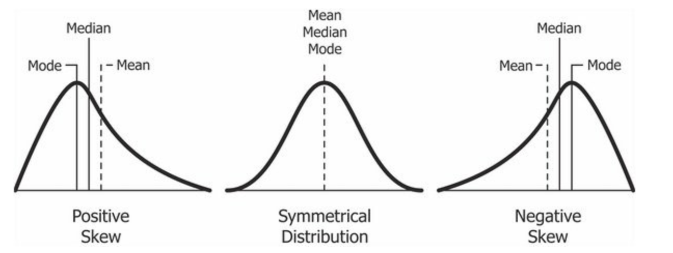
Skewness

Slide 10
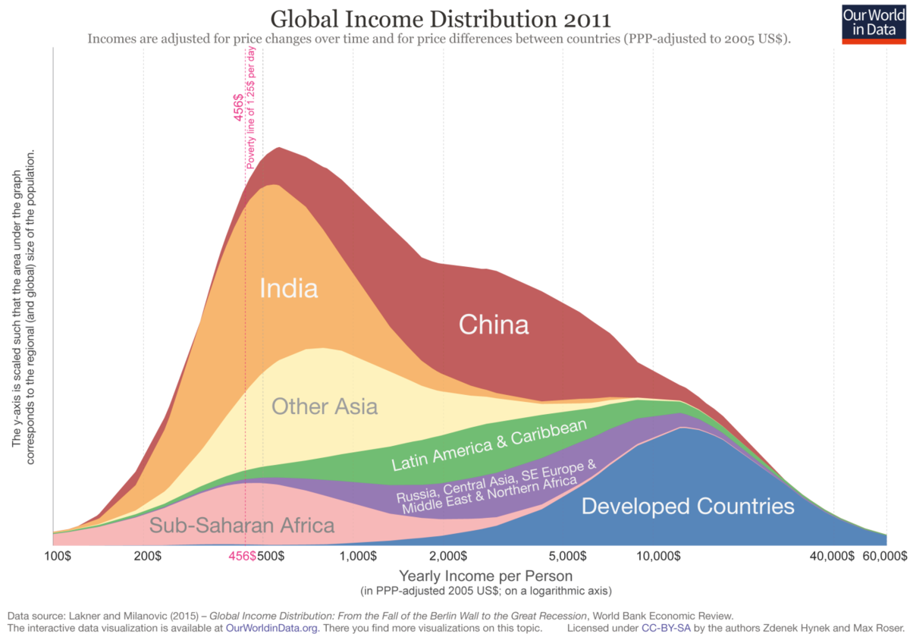
Skewness

Slide 11
Quantiles, Quintiles and Other ‘Tiles’
3

Slide 12
Quantiles
A quantile is a measure that cuts the data into n pieces. A quantile we are very familiar with by now is the n = 2 quantile, also called the median.
We can have n = 3 quantiles, called tertiles, n = 4 quantiles, called quartiles. However, we can have as many quantiles as we like.

Slide 13
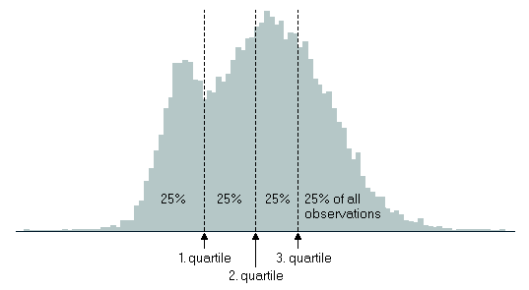
Quantiles

Slide 14
The End.

